Slide 1

CAPSTONE PROJECT
Digits Recognition Neural Network
Final Project
Presented By
Vijay S K
711721244063
III Btech CSBS
KGiSL Institute of Technology
3/21/2024 Annual Review
1

Slide 2

PROJECT
Classify Handwritten digits using a simple neural network
3/21/2024 Annual Review
2

Slide 3



AGENDA
1. Problem Statement
2. Project Overview
3. End Users
4. Solution and Value Proposition
5. The Wow Factor in Your Solution
6. Modelling
7. Results
3
3/21/2024 Annual Review

Slide 4

PROBLEM STATEMENT
Address the challenge of handwritten digit recognition, emphasizing the need for accurate and efficient classification algorithms.
Discuss the significance of digit recognition in various industries, including finance, healthcare, and logistics, for tasks such as document processing and automated data entry.
3/21/2024 Annual Review
4

Slide 5

PROJECT OVERVIEW
Provide an overview of the project's objective: to develop a neural network-based solution for classifying handwritten digits.
Introduce the MNIST dataset and its role in training and evaluating the model, consisting of 60,000 training images and 10,000 testing images of handwritten digits.
3/21/2024 Annual Review
5

Slide 6

WHO ARE THE END USERS?
Identify potential end users and beneficiaries of the solution, including businesses seeking automation in data processing, developers working on image recognition applications, and researchers exploring machine learning techniques.
3/21/2024 Annual Review
6

Slide 7

SOLUTION AND ITS VALUE PROPOSITION
Present the solution: a neural network model trained to accurately classify handwritten digits.
Highlight the value proposition, such as increased accuracy, scalability, and adaptability to different digit recognition tasks.
3/21/2024 Annual Review
7

Slide 8

THE WOW IN YOUR SOLUTION
Showcase unique aspects or innovations incorporated into the solution, such as novel network architectures, optimization techniques, or data augmentation strategies.
Illustrate how these elements contribute to the model's performance and distinguish it from existing approaches.
3/21/2024 Annual Review
8

Slide 9
MODELLING
Explain the neural network architecture employed in the project, starting from a basic model with input and output layers, and then progressing to a more complex model with hidden layers.
Discuss key design choices, such as activation functions, loss functions, and regularization techniques, and their impact on the model's performance.
3/21/2024 Annual Review
9

Slide 10
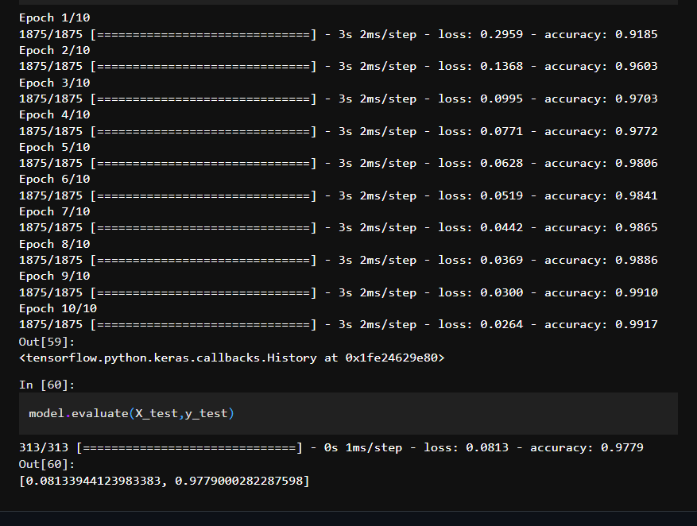
RESULTS
Demo Link
3/21/2024 Annual Review
10

